Slide 1
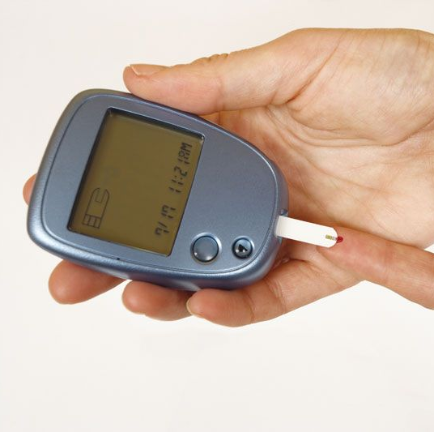
Diabetes Mellitus

Slide 2
What is Diabetes Mellitus?
Diabetes is a chronic health condition that affects how your body turns food into energy.
Your body breaks down most of the food you eat into sugar (glucose) and releases it into your bloodstream.
When your blood sugar goes up, it signals your pancreas to release insulin which acts like a key to let the blood sugar into your body’s cells for use as energy.
With diabetes, your body doesn’t make enough insulin or can’t use it as well as it should.

Slide 3

Statistics
Type 1 - Approximately 5-10% of the people who have diabetes have type 1
Type 2 - About 90-95% of people with diabetes have type 2.
Men are almost twice as likely to develop type 2 diabetes as women.
Diabetes puts both men and women at greater risk for heart disease, stroke, vision loss, kidney failure, even amputations.
https://www.cdc.gov/diabetes/library/features/diabetes-and-men.html

Slide 4
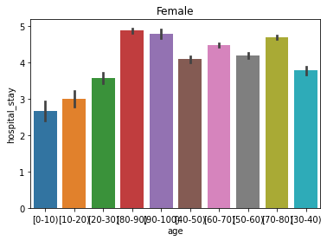
Thesis: Does age and gender play a role in the length of time people with diabetes is hospitalized?
The data analyzed both males and females in different age groups ranging from 0-10 up to 90-100.
The results shows a steady rise in hospital stays as the individual gets older.
Between the ages of 40-60 individuals recovered at the same rate, however, between the ages of 80-100, individuals spent more time recovering in the hospital

Slide 5
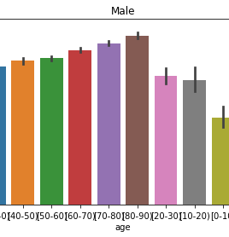
Males between the age groups 10-30 spend between 3 – 3.5 days recuperating in the hospital
However, the data shows a steady however, small upward spike for individuals between the age groups 40-90, with the longest hospital stay occurring with individuals older than 90

Slide 6
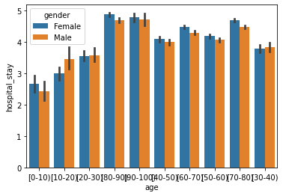
Analysis
Both males and females develop diabetes, either Type 1 or Type 2, and suffer from diabetic related complications as a result
After analysis of research conducted among different age groups, the data shows that the incident of hospitalization is prevalent throughout each age groups and gender.
However, as individuals age, the length of hospital stays increase from 2.5 days to upwards of 4.5 days. This is true for both males and females.

